Slide 1

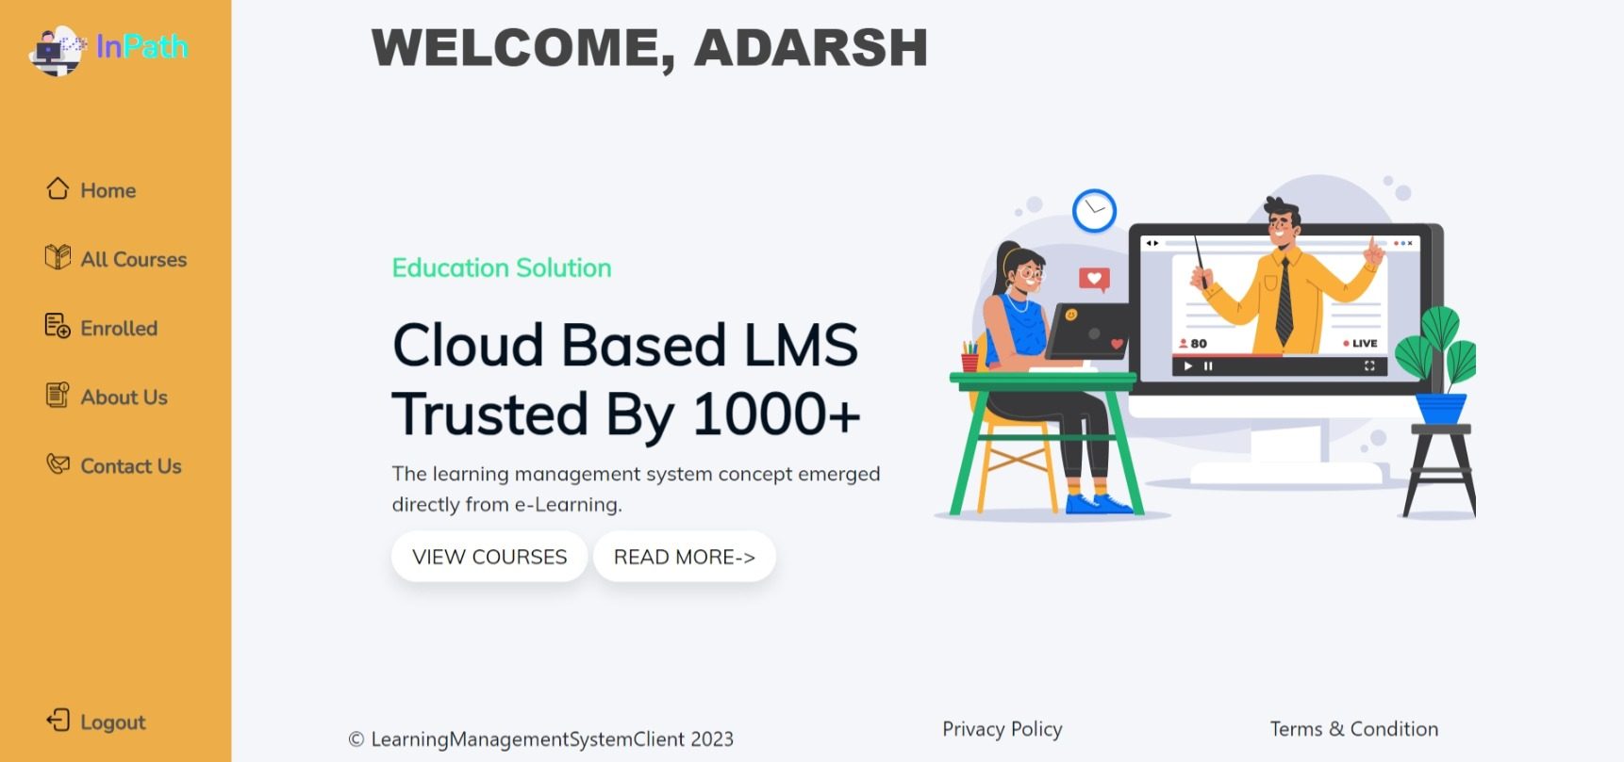
In Path

Slide 2
Outline
Problem Statement
Objective
Onboarding-Architecture
Project Flow
Technology and Tools Used
Conclusion

Slide 3

Problem Statement
Expensive Off-Site or Live Training
Lack of Time to Get Trained After Work Hours
All content at same place, You can access it from anywhere

Slide 4
Objective
Essentially, an LMS delivers educational content to its users in a centralized location. A learning management system is a Web App that provide training material. It also handles a variety of other tasks, including the following:
Registering courses
Handling course administration
Handling User Administration
Learn Anytime Anywhere

Slide 5
Architecture
Front End
MVC
API
User Controller
Admin Controller
Enroll Controller
POST /GET/
DELETE
SQL Server
GET/DELETE

Slide 7
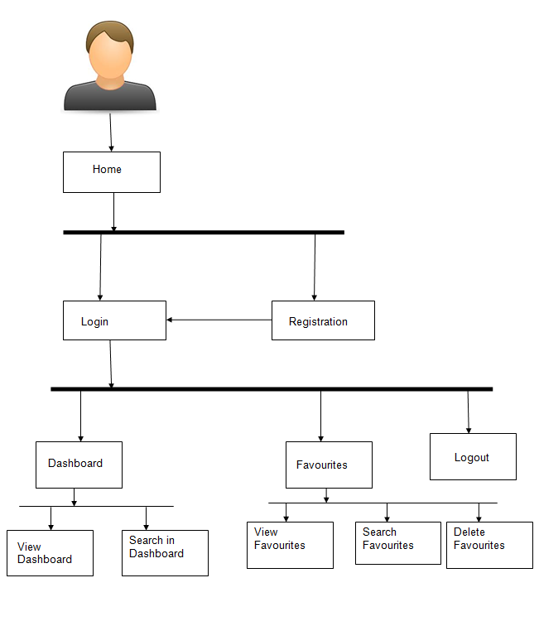
Project Flow
Home Page
Login
Register
User
Admin
Recommends
Browse Course
Enroll Course
Add Course
Edit Course
Delete Course
Add User
Search Books

Slide 8




Technologies and Tools Used

Slide 9
Conclusion
The LMS app helps the user to learn latest technologies Online.
It also helps user to browse latest course and register in course.

Slide 10
Thank You

